Slide 1
Data Wrangling Assignment 2
Name: Loke Kai Fong
Student No.: 10204160J
Class: P02

Slide 2
Contents
1
2
3
Introduction
Data Exploration
Data Wrangling on Multiple Tables
4
5
6
Conclusion & Further Improvements
Data Cleansing & Transformation
Machine Learning Model

Slide 3
Introduction
1

Slide 4
Introduction
Dataset Background Info
Objectives
Conduct Data Exploration
Formulate Prediction Problem
Perform Data Wrangling & Data Transformation
Build & Evaluate a Machine Learning Model
F1 AKA Formula 1 racing data is used as dataset.
Formula 1 is the highest class of international racing for open-wheel single-seater formula racing cars.
F1 racing data is taken from Ergast.com.

Slide 5
Data Exploration
2

Slide 6
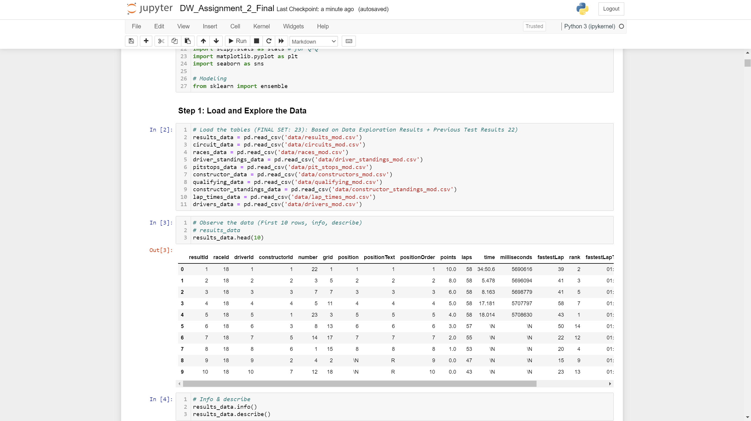
Load Data into Jupyter

Slide 7
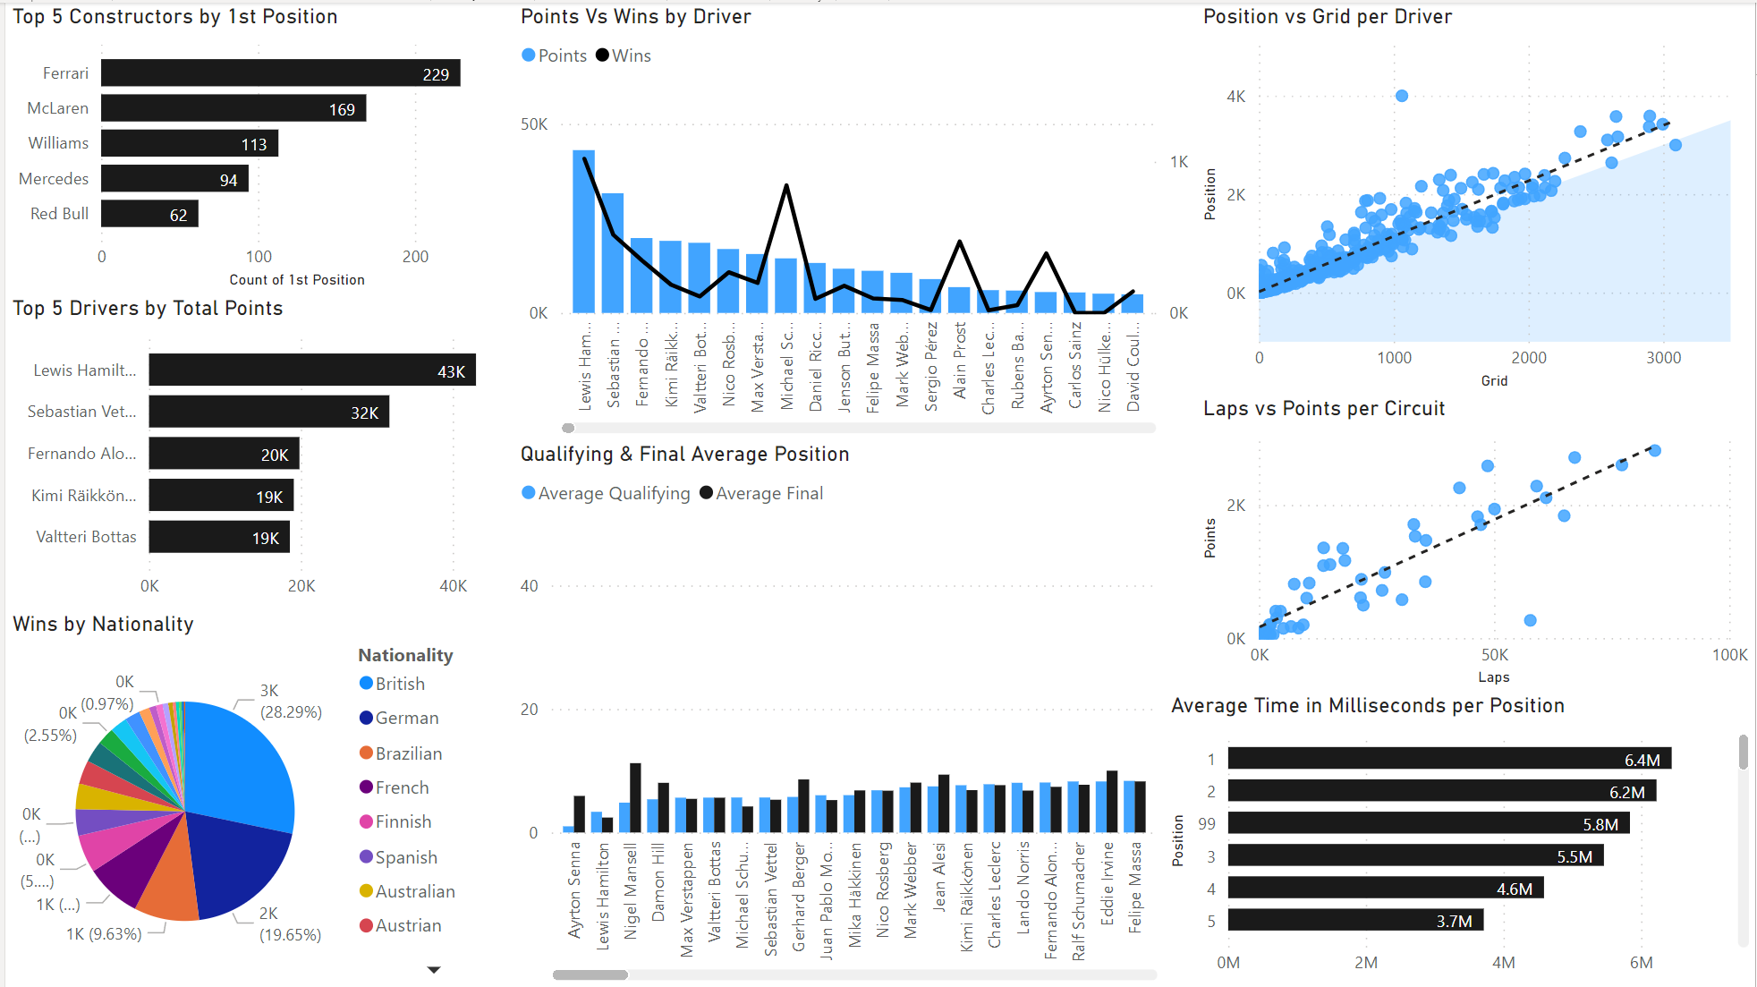
Data Exploration

Slide 8
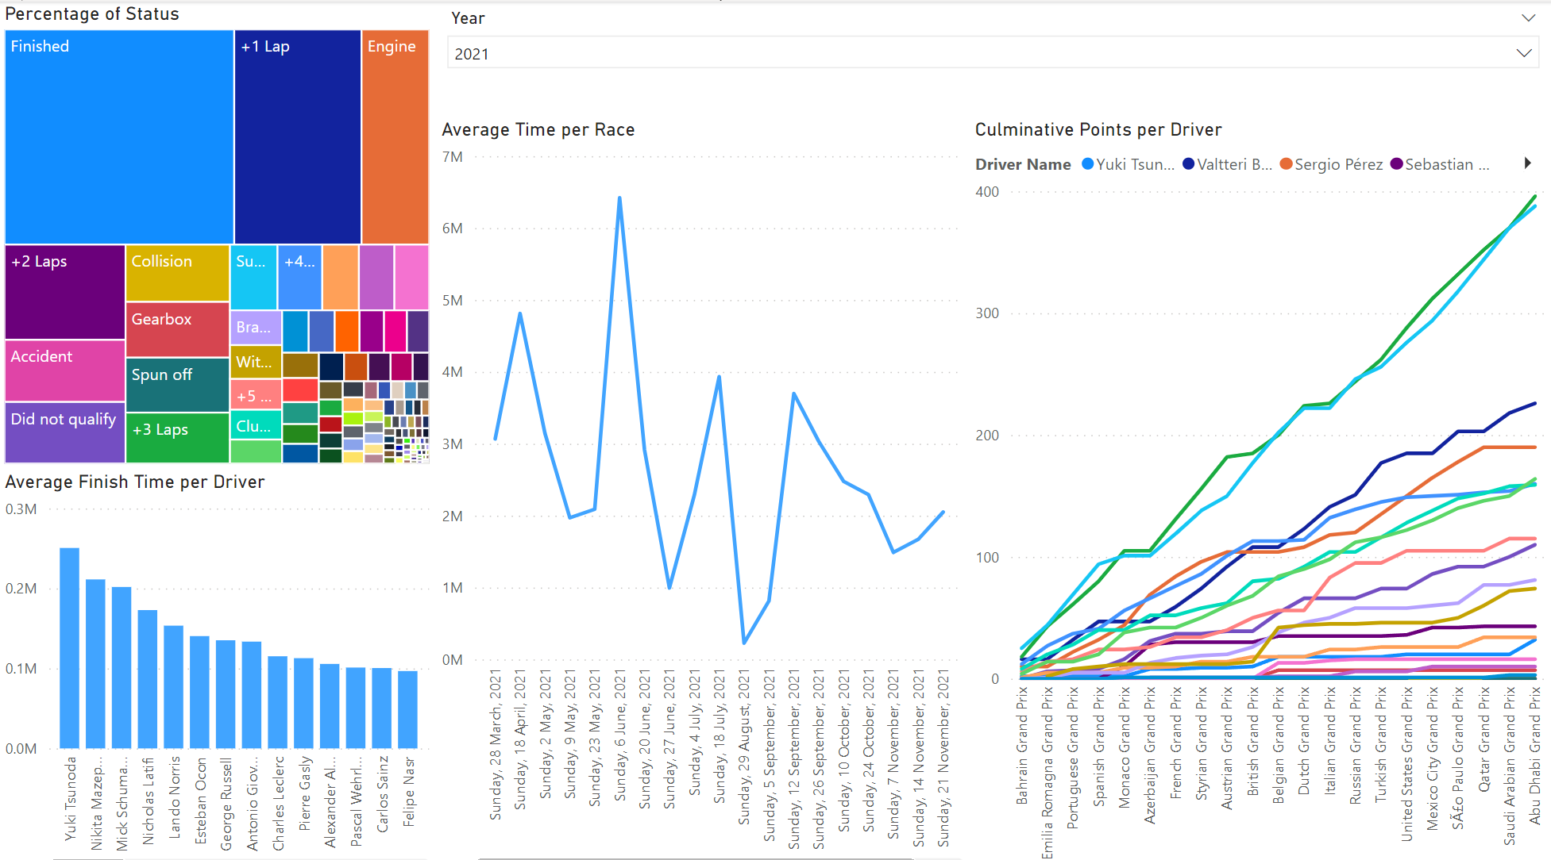
Data Exploration

Slide 9
Prediction Problem Statement
“Predict if a driver will obtain a podium position for a race”. (Logistic Regression Model)

Slide 10
Data Wrangling
3

Slide 11
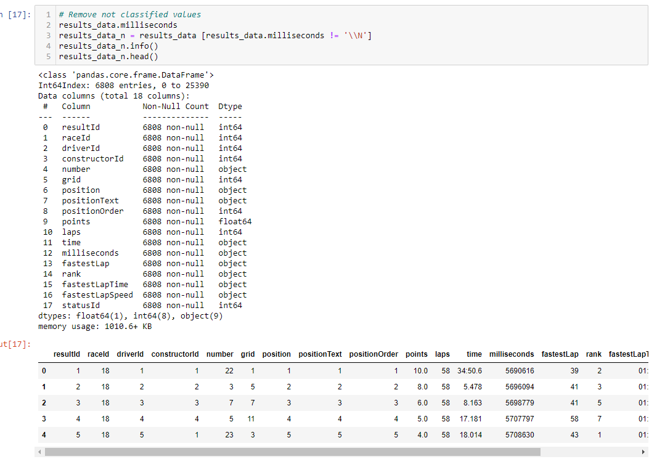
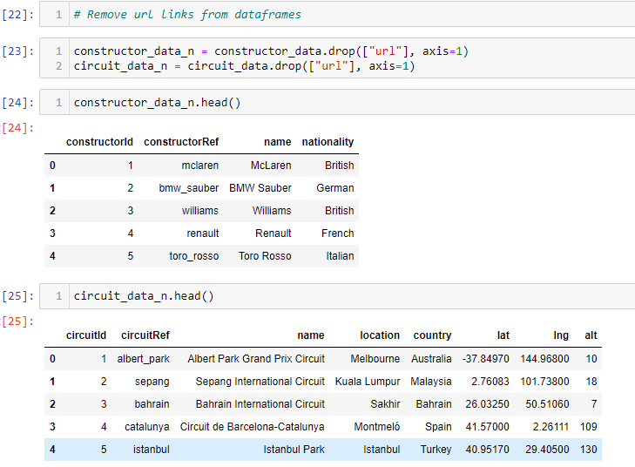
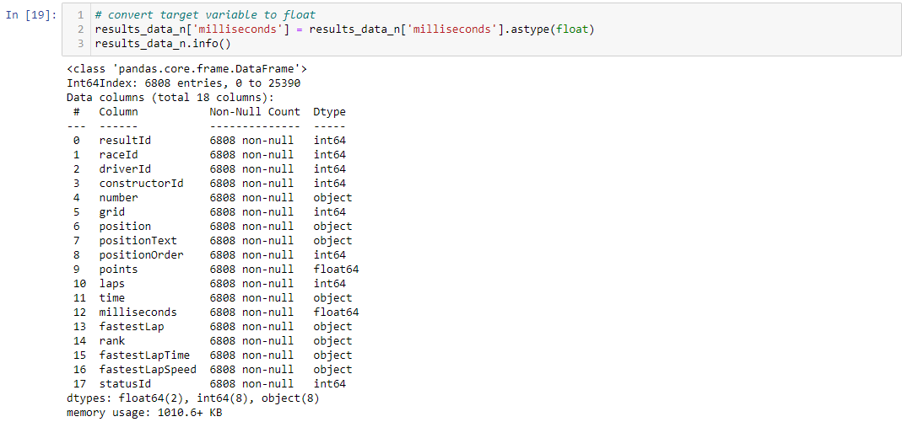
Remove/Filtering Out Data

Slide 12
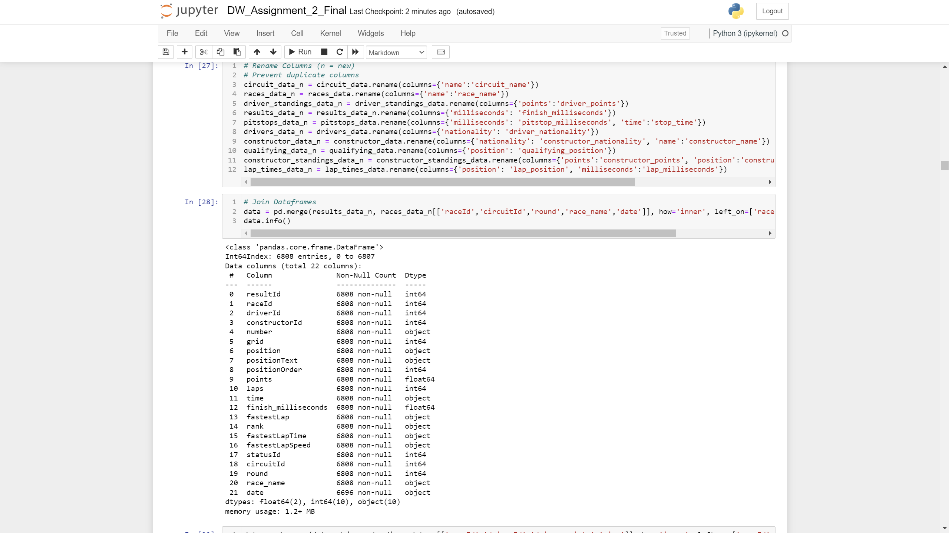
Rename Columns

Slide 13
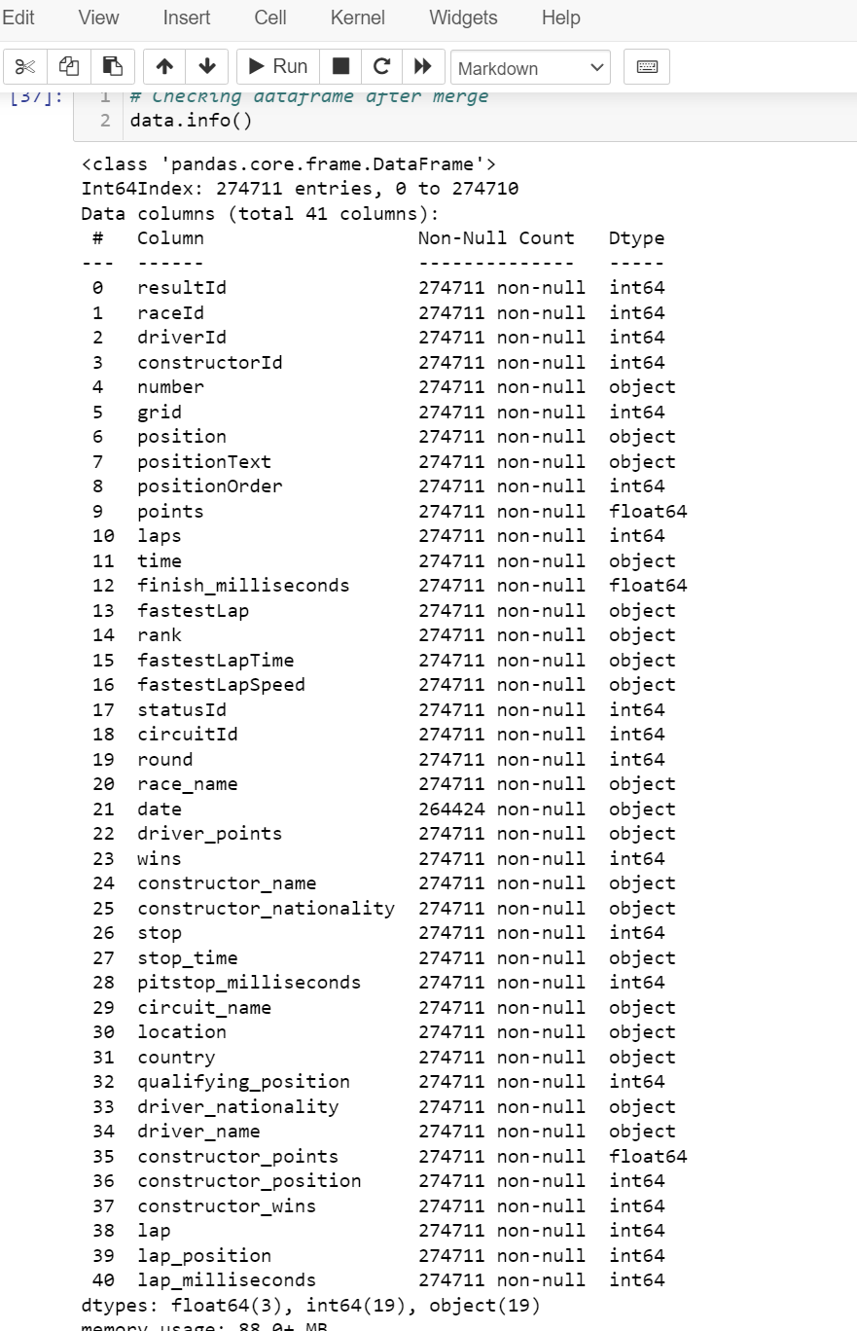
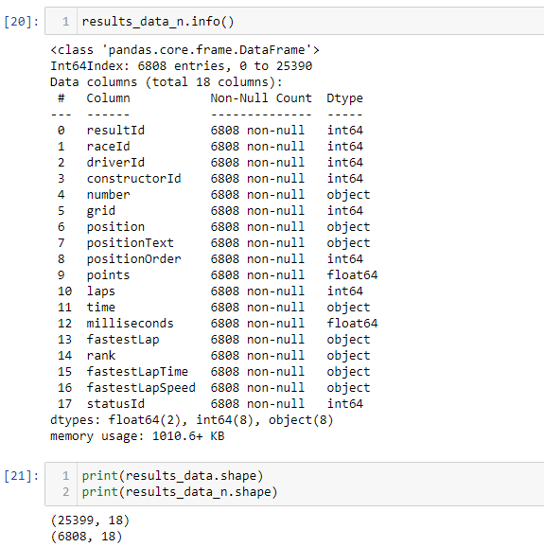
Join Datasets

Slide 14
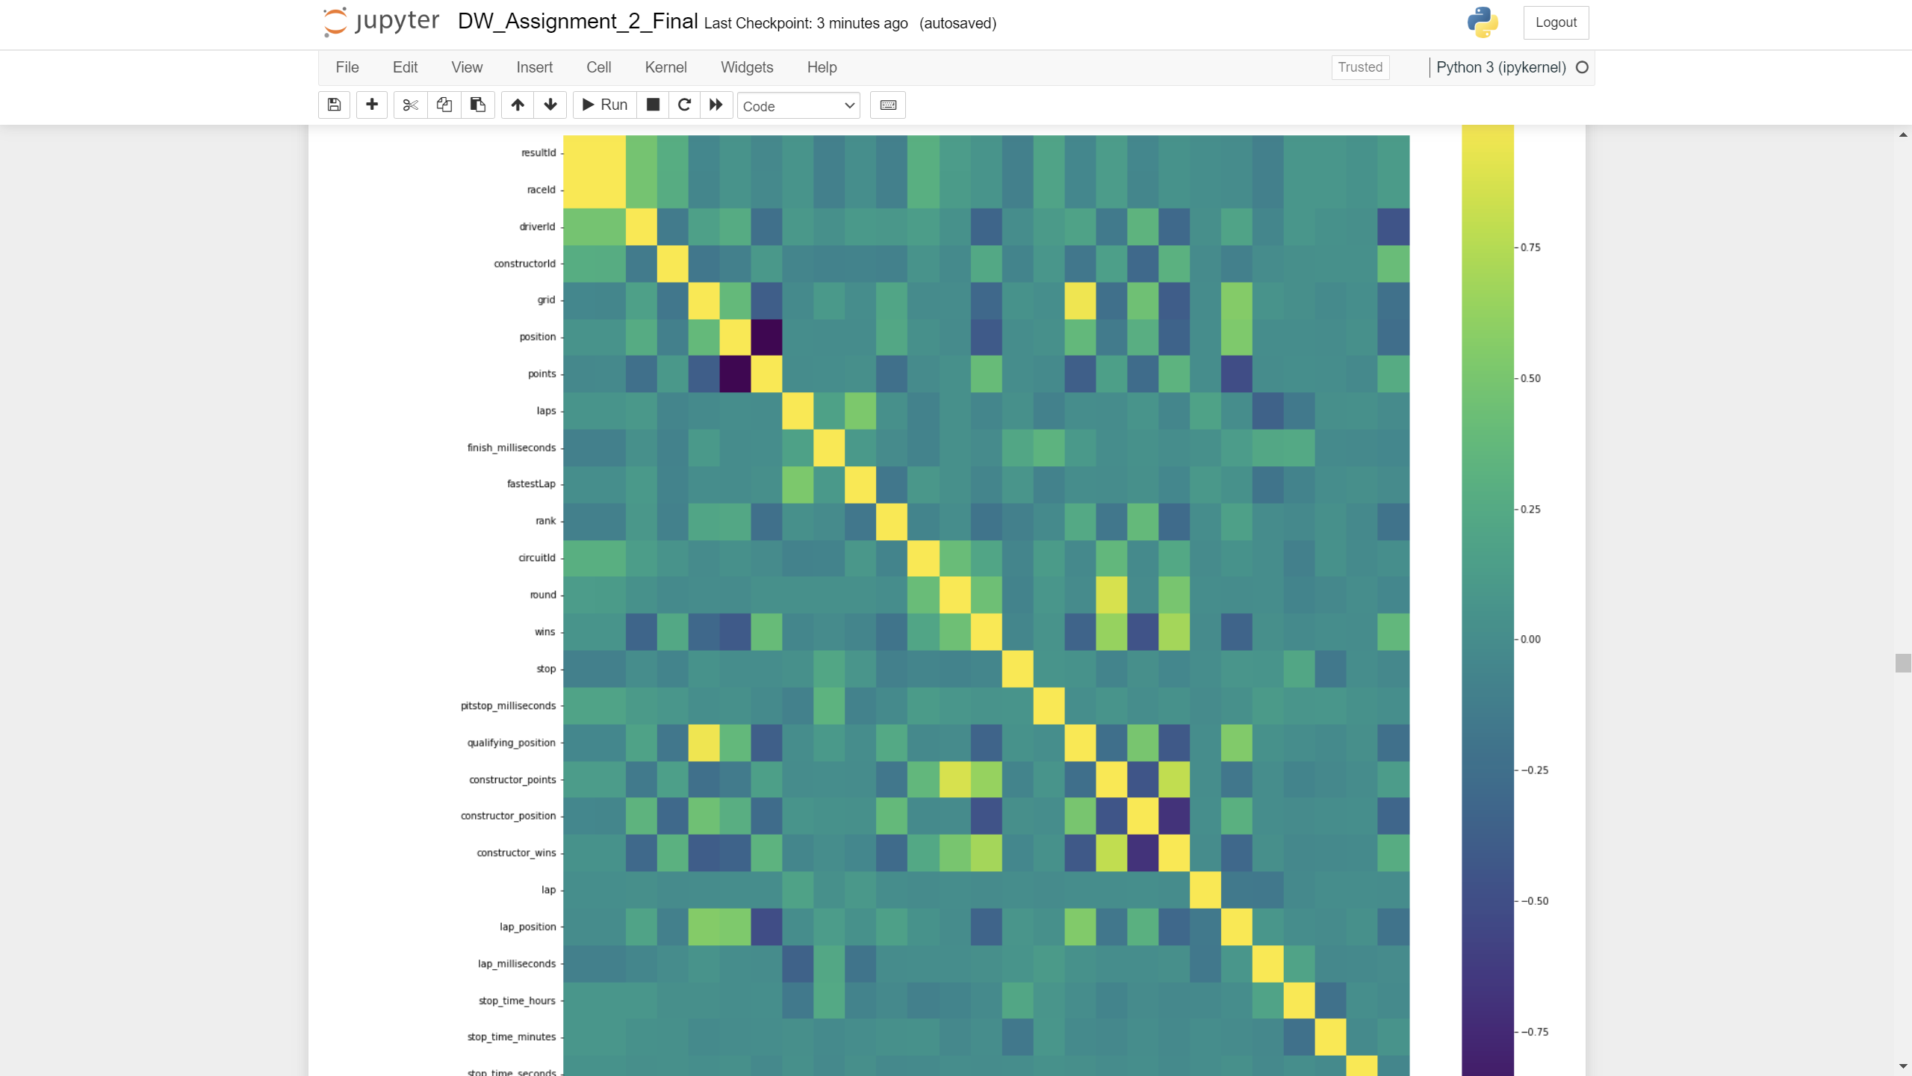
Observe Correlation

Slide 15
Data Transformation
4

Slide 16
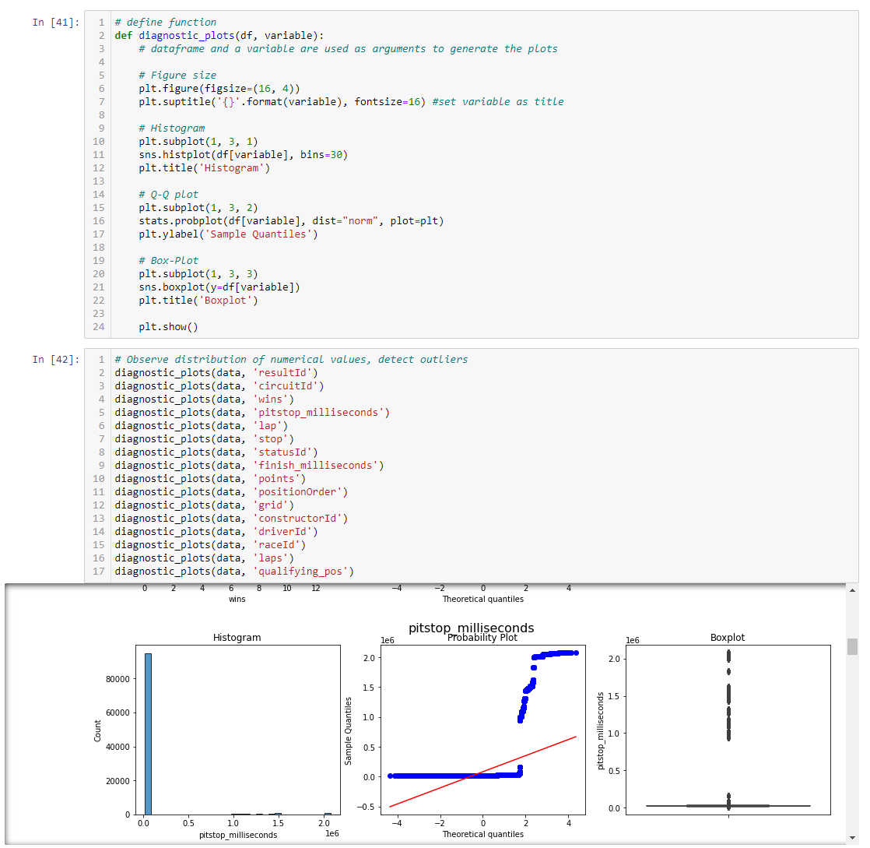
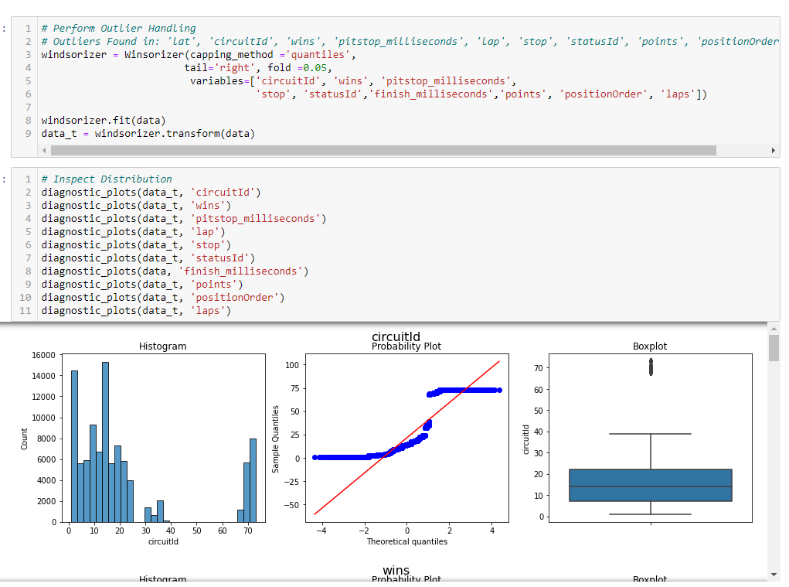
Step 1: Outlier Handling

Slide 17
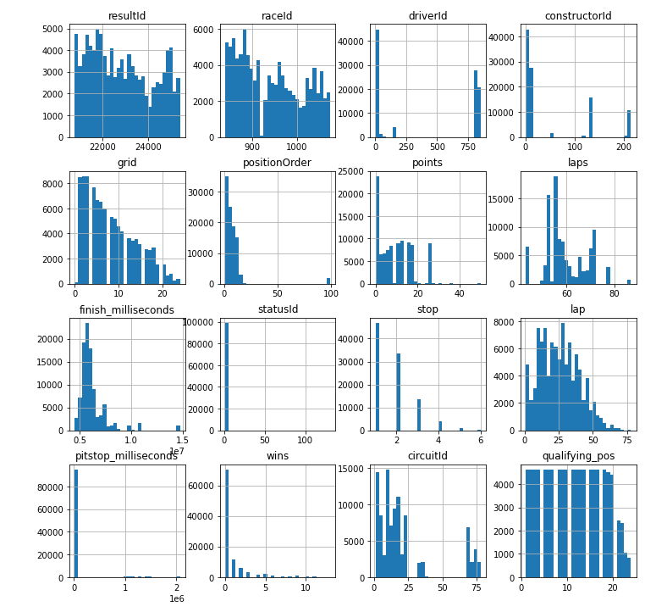
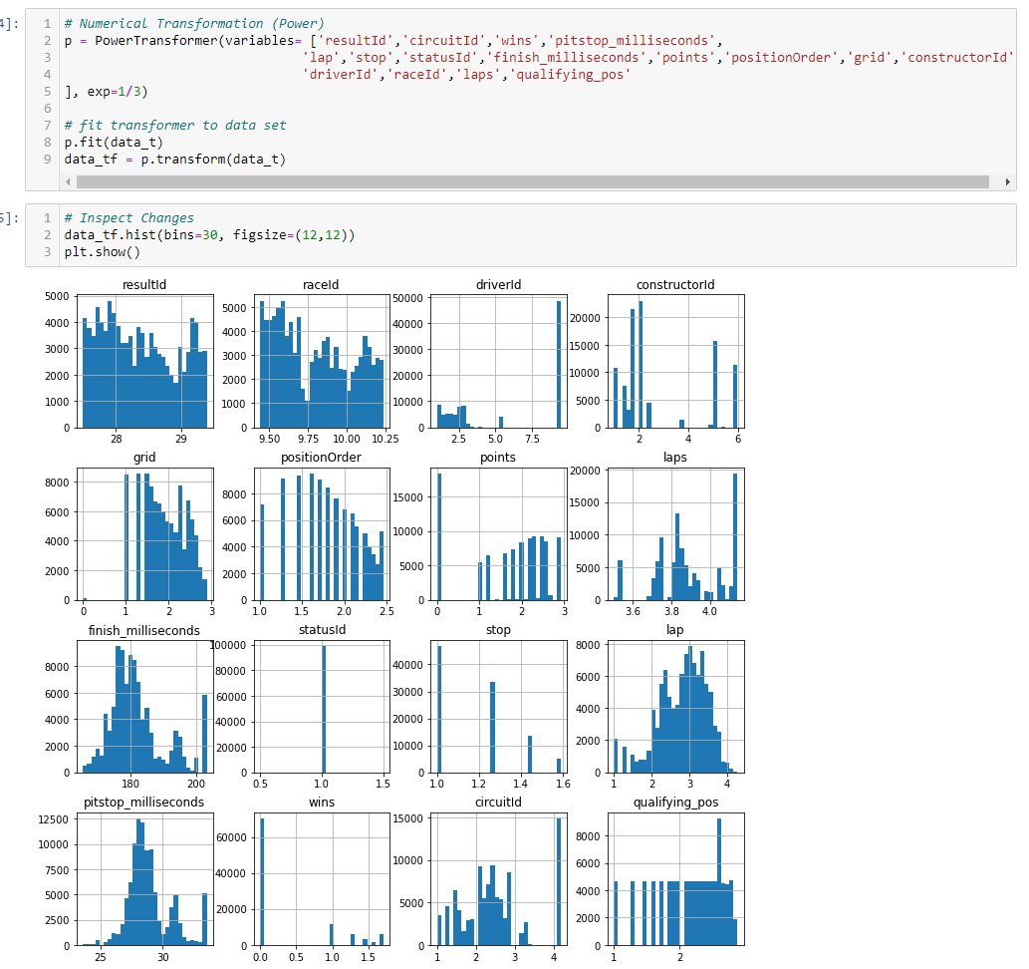
Step 2: Numerical Transformation

Slide 18
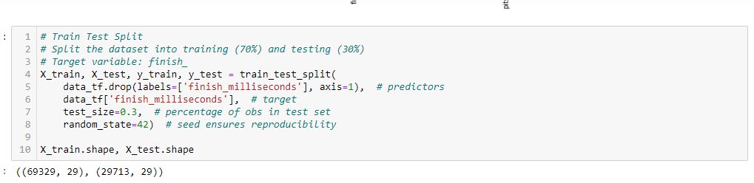
Step 3: Train Test Split

Slide 19
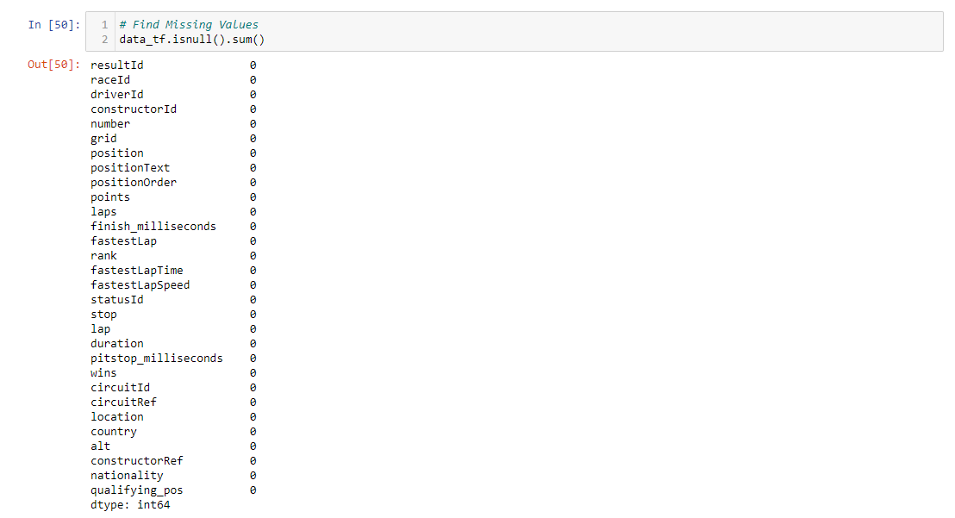
Step 4: Handle Missing Values
No Missing Values Found

Slide 20
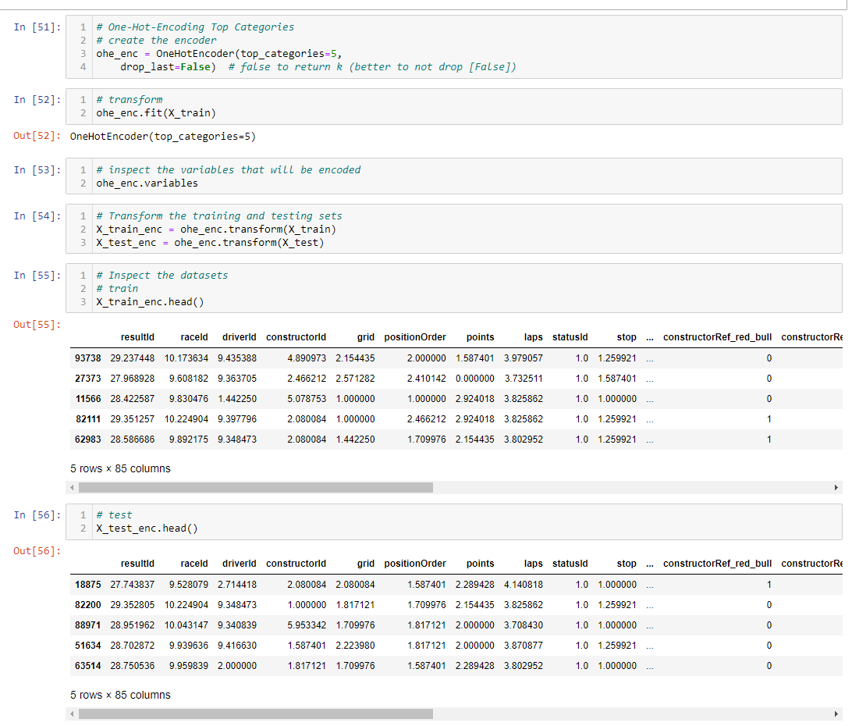
Step 5: Categorical Encoding

Slide 21
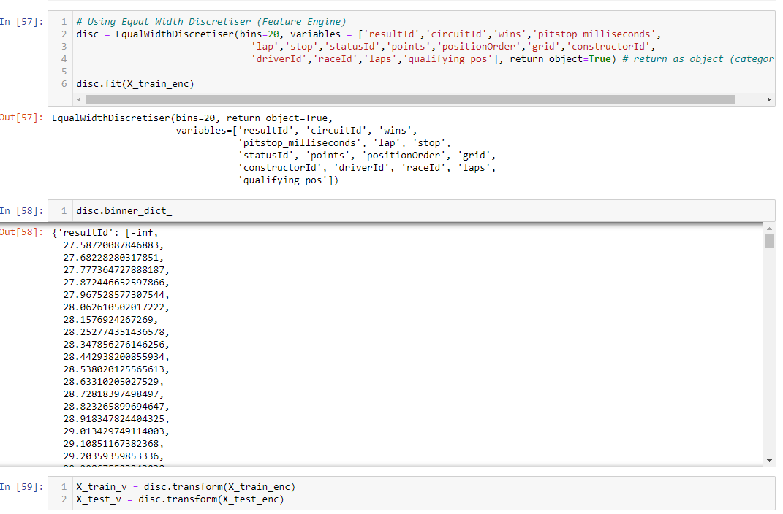
Step 6: Variable Discretization

Slide 22
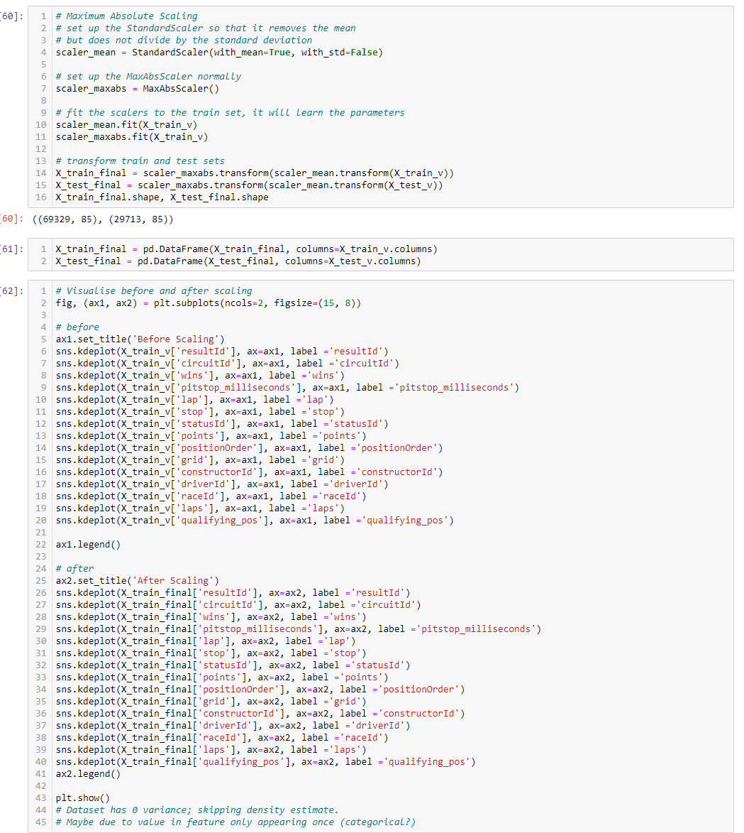
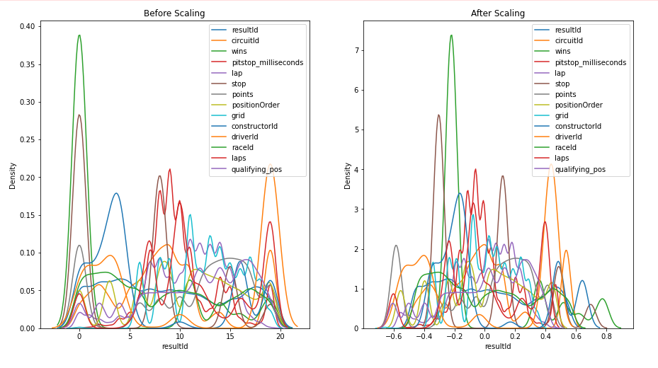
Step 7: Feature Scaling

Slide 23
Machine Learning Model
5

Slide 24
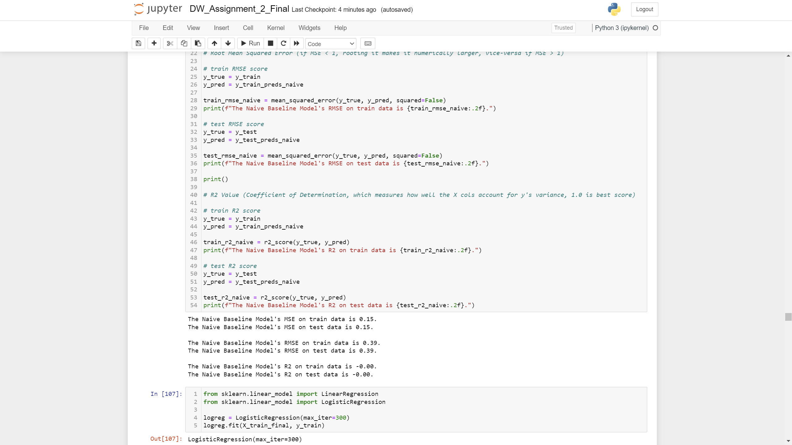
Naïve Baseline Model

Slide 25
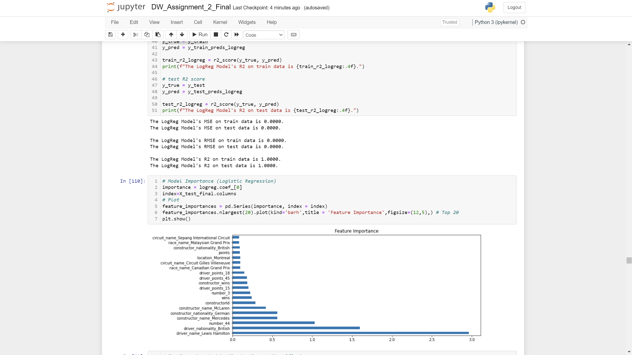
Linear Regression Model

Slide 26
Further Improvements
6

Slide 27
Further Improvements
Revisit Data Exploration section.
Prevent data Leakage
Add or remove datasets from current model to improve performance.
Test & compare other data transformation techniques.

